Slide 1
Jazz Pre-Configured Application Processor Cores
Products & Solution Overview

Slide 2
Jazz Family - Product & Application Overview
Jazz DSP
Configurable
VLIW - DSP
Jazz 2010 General Purpose - DSP
Jazz 2020 Dual MAC – DSP
Jazz 2040 Quad MAC – DSP
Jazz Tempo Comm - DSP
Jazz Voice
Telecommunication
Processor Core
Jazz Media
Consumer Media
Processor Core
VVP VoIP Solution
IP Video Phone (Voice & Video)
VoIP Home Gateway (2-4 Channel)
VoIP IAD Gateway (12 -32 Channel)
- VoIP CO Gateway (to 1024 channel)
-MMP Mobile Phone & Media
QVGA Media Processing
DAB/DMB/DVB-H Media
HD Video Processing
Audio Processing

Slide 3
Table of Contents – Pre-Configured Jazz Media Products
Implementation Ready Pre-Configured Application Processor Cores
  Jazz “DSP” - Robust Low Power, High Performance DSP Cores
  Jazz “MMP” - Mobile Media Processor
  Jazz “BMP” - Video Broadcast Media Processor
  Jazz “AAP” – Advanced Audio Processor
Each Jazz core has a single or dual, application-specific processor that combine a general-purpose instruction set with application-specific instructions that accelerate media processing functions.
All Jazz processors are very-long instruction word (VLIW) processors containing embedded memory, a host bus interface (HBI) that can connect to most standard on-chip buses including AMBA, OCP and Wishbone, and a media-aware DMA memory interface called the Data Channel Interface (DCI).

Slide 4
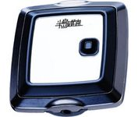
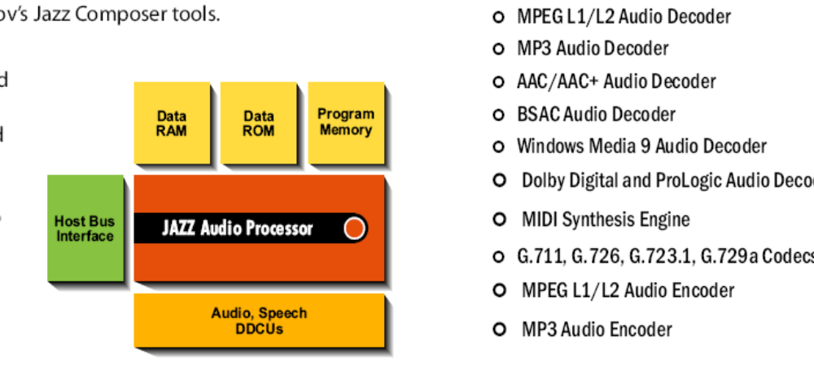
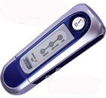
Jazz AAP - Advanced Audio Application Processor
The AAP media software modules have been designed to fully exploit the unique advantages of the AAP architecture. The AAP family includes the following modules:
MPEG L1/L2 Audio Codec
MP3 Audio Codec
AAC / AAC+ Audio Decoder
BSAC Audio Decoder
Windows Media 9 Audio Decoder
Dolby Digital & Prologic Audio Decoders
MIDI Synthesis Engine
G.711, G.726, G.723.1, G.729a Codecs
All modules delivered in source code so you can add your own algorithms (e.g., motion estimation)

Slide 5
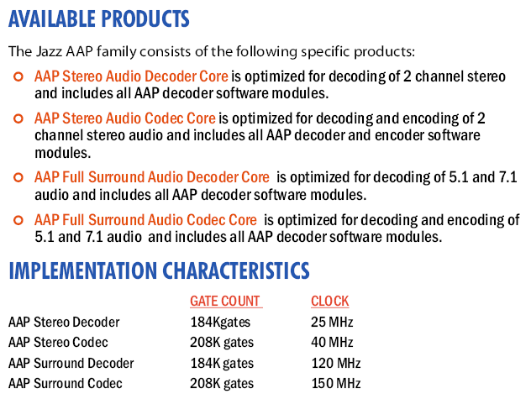
Jazz AAP – Advanced Audio Processor Products

Slide 6
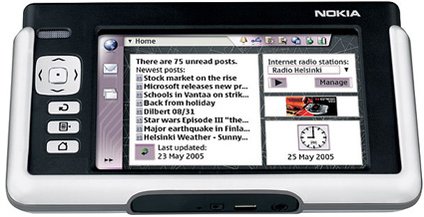
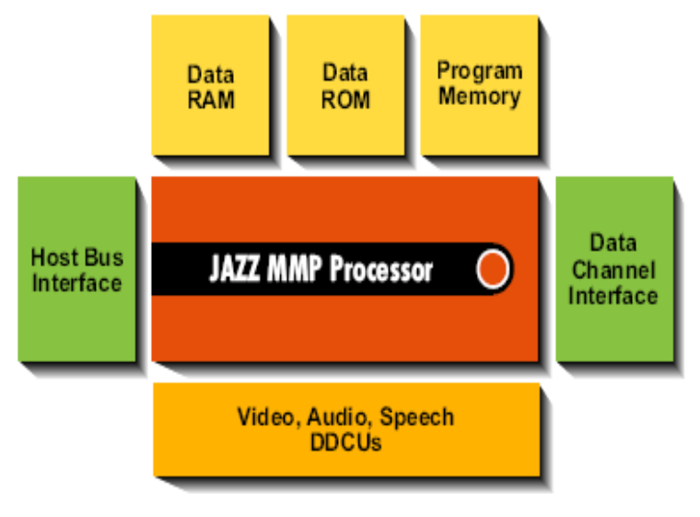
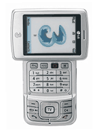
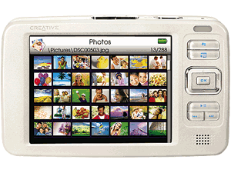
Jazz MMP - Mobile Media Application Processor
The MMP media software modules have been designed to fully exploit the unique advantages of the MMP architecture. The MMP family includes the following modules:
H.264 AVC Baseline Video Decoder
MPEG4 Simple Profile Codec
Window Media 9 Video Decoder
MPEG L1/L2 Audio Decoder
MP3 Audio Decoder
AAC / AAC+ Audio Decoder
MPEG L1/L2 Audio Encoder
MP3 Audio Encoder
BSAC Audio Decoder
Windows Media 9 Audio Decoder
JPEG Still Image Codec
G.711, G.726, G.723.1, G.729a Codecs
All modules delivered in source code so you can add your own algorithms (e.g., motion estimation)

Slide 7
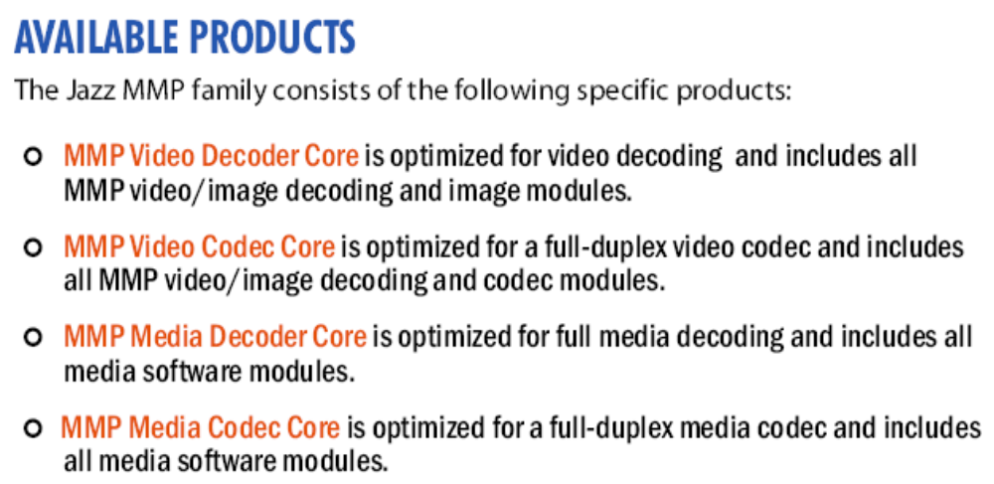
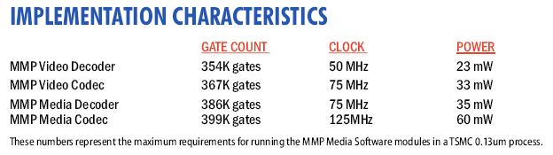
Jazz MMP - Mobile Media Products

Slide 8
Jazz Mobile Media MMP - Platform & Application Support
Jazz MMP Processor
Application Support
180, 130, 90nm process
Ultra-low power performance
Unique programmable, multiple engine VLIW architecture
Supports ARM, MIPS & Open RISC
Supports Linux 2.6
Industry-leading graphics support with DSP-based video imaging, and audio accelerator
  Video broadcasting support for emerging standards like DVB-H, S-DMB, T-DMB and ISBD-T
  CIF, QVGA & D1 up to 720p resolution
  JPEG & M-JPEG imaging
  Advanced Audio - MP3, AAC-AAC+ MPEG2 L1/L2 & Dolby®
  FPU support for 3D graphics & audio effects
  Microsoft (WMV), Apple (QuickTime) & Qualcomm (Brew-MediaFlo)
Jazz MMP - Simultaneous VLIW Parallel Processing

Slide 9
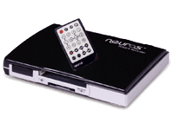
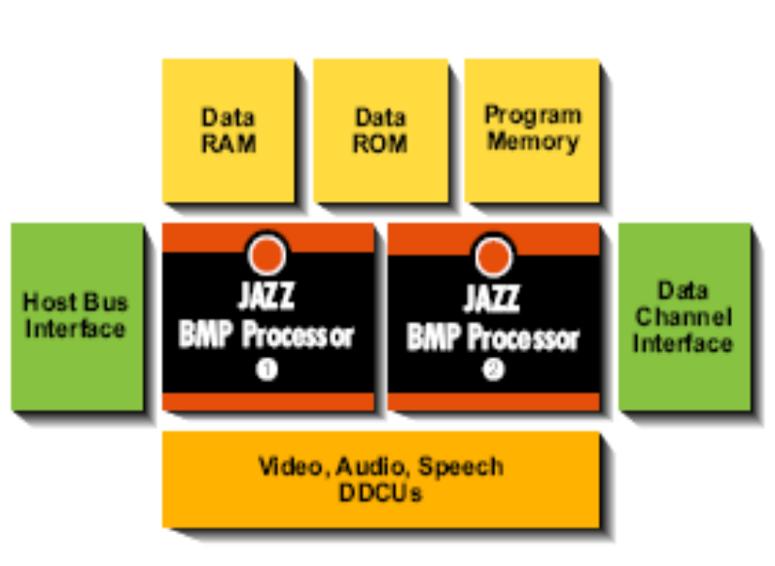
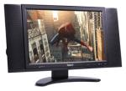
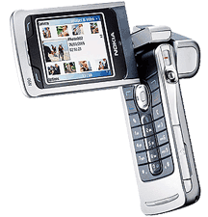
Jazz BMP - Broadcast Media Application Processor
The enhanced BMP media software modules have been designed to fully exploit the unique advantages of the BMP architecture. The BMP family includes the following modules:
H.264 AVC Main & High Profile Video Decoder
MPEG4 Advanced Simple Profile Codec
Window Media 9 Video Decoder
MPEG L1/L2 Audio Decoder
MP3 Audio Decoder
AAC / AAC+ Audio Decoder
MPEG L1/L2 Audio Encoder
MP3 Audio Encoder
BSAC Audio Decoder
Dolby Digital Audio Decoder (5.1/7.1)
Windows Media 9 Audio Decoder
JPEG Still Image Codec
G.711, G.726, G.723.1, G.729a Codecs
STB, PVR & DVD
Player Integration
All modules delivered in source code so you can add your own algorithms (e.g., motion estimation)

Slide 10
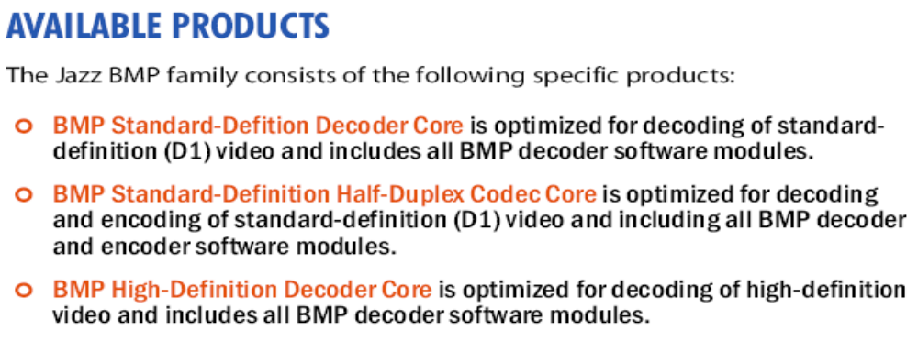
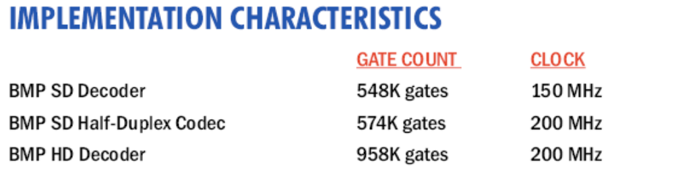
Jazz BMP – Broadcast Media Application Processor

Slide 11
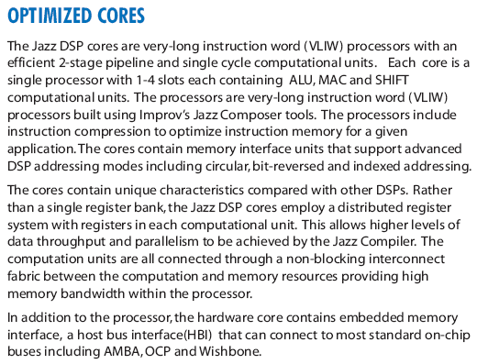
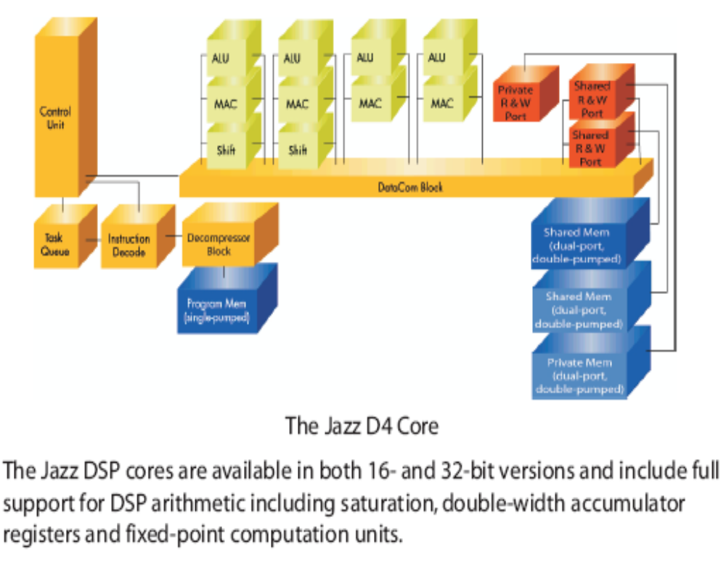
Jazz DSP – Robust Low Power, High Performance DSP Cores

Slide 12
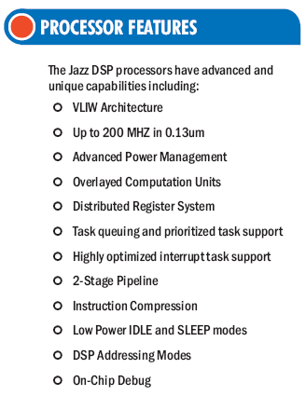
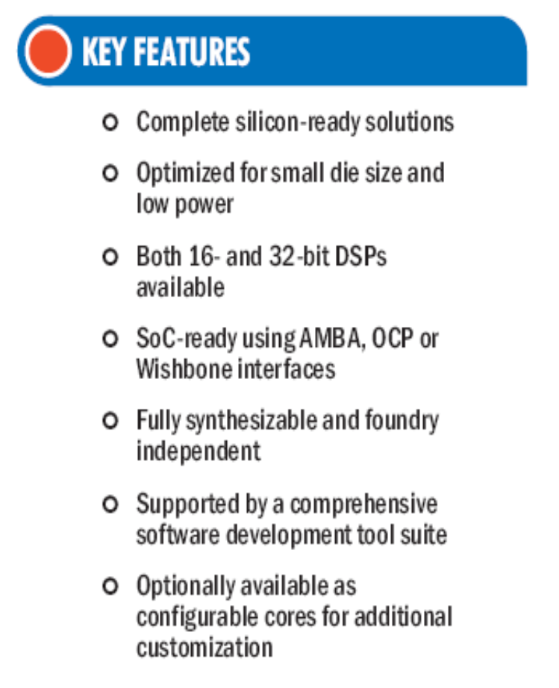
Jazz DSP – Robust Low Power, High Performance DSP Cores

Slide 13
Jazz Media Processing - Hardware Accelerators
Jazz Media - H/W Acceleration – DDCUs for Media Processors
BitStream
  Reading and writing to/from bitstream buffer
BitStream w/Huffman Tables
  Same as above but includes loading and processing of Huffman tables for video; also reduces data memory requirements
DCT/IDCT
  Optimized datapath for DCT/IDCT operations
IDCT
  Optimized datapath for IDCT operations
SIMD Adder
  ALU optimized for video data widths and operations
H-Interpolator
  Interpolation and clipping operations
MP3 Table Accelerator
  Holds majority of MP3 Huffman tables and optimizes access; significantly reduces on-chip data memory requirements (over 3 sq. mm in 0.18).
GMC
  Optimizes key algorithms used in global motion compensation
Six Tap
  Six tap filter used in H.264 processing
Inverse 4x4 Transform
  Optimized for the H.264 4x4 transform
CABAC /CAVLC
  Acceleration of the CABAC/CAVLC processing in H.264
ADLU
  Speech processing accelerator
Custom H/W accelerators developed by Improv included within the Jazz Media Solution Kits:

Slide 14
Improv’s Key Value Proposition
High Performance Applications
  Create application-optimized processing engines for your target market
  Instruction-level parallelism combined with custom instructions/accelerators
Rapid Time-to-Market Deployment
  Rapid methodology to design advanced processing engines
  Create application-optimized processing engines specific to your needs
  Fully automated path from application to implementation
Enables Design for Profit
  Lowest performance to power ratio versus any product on the market
  Control balance between performance and die size
  Programmability allows multiple products from a single die
Improv’s technology allows our customers to rapidly create highly competitive solutions for high volume application markets

Slide 15
Jazz SOC Integration
SOC Host Software Package
  ANSI-C compliant API for configuring, controlling and running all application modules in an integrated framework
  Supports up to 4 streams of data for video and audio
  full on-chip debug (JTAG) integration
Host Bus Interface – Jazz HBI
  Hooks directly into host busses including AMBA™ AHB (ARM) and OCP
  Can be configured for different custom busses and Interface
  Mailbox-style interface for communicating with host processor
Bit Stream FIFO
  Efficient management and communication for loading the bit stream buffer
Time Domain Manager
  Time slice data interface
Data Channel Interface – Jazz DCI
  High-performance, “media aware” DMA for moving blocks of video data to and from memory
  Different configurations for different memory layouts of video data in memory

Slide 16
Jazz Tools & Support
The Jazz Standard Tool Suite is for software development and includes the Notation
environment, Complier/Assembler, Instruction-set Simulator and Profiler. The Jazz
Composer Tool Suite includes all of the Standard Suite features and additionally
allows customization of all Jazz DSP’s and platforms.
Tool Technology Summary
  Composer – graphical tool for creating custom platforms, processors and accelerators
  VLIW Compiler
  Profiling and Analysis Tools
  Java and C-based system-level design methodology
  Instruction-Set Simulator
  Automatic Generation of RTL databases and EDA scripts

Slide 17
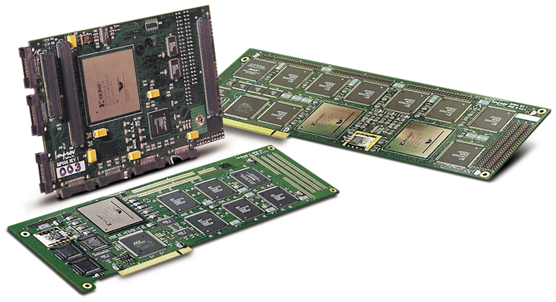
Improv Emulation & Development Boards
Improv Jazz PSA RehearsalTM Development Boards
Processor and System Verification
  Jazz PSA RehearsalTM XE2-6K
  Dual FPGA (2-4 processor)
  configuration; PCI-based
  Map “Composed” JazzTM processors onto FPGA technology, execute and test application code - includes full debugger support
  Use same test bench for functional, ISS and RehearsalTM board simulation
  Windows NT drivers – Multiple Configurations

Slide 18
The Improv Advantage
Breakthrough configurable & pre-configured DSP architecture
Industry’s most efficient DSP and compiler combination*
Jazz Pre-Configured Cores come as silicon-ready solution
Optimized for small die size and low power
Low clock rates for advanced media standards (Available in audio, video and voice configurations)
Reduces CPU processing load by 75-90%.
Fully synthesizable and foundry independent
Supported by a complete software development tool suite
Industry’s most versatile DSP to meet designer’s application specific needs
  Black-box Application Cores for Media Processing and VoIP
  Highly Flexible Design methodology & development environment
  Complete SoC integration and methodology
Optionally available as configurable cores for additional customization
*Certified by EEMBC. Telemark score July 2002

Slide 19
Jazz DSP Processor Platform Offerings
Pre-Configured Application Processors
Improv ‘Fixed' Core processors come pre-configured with “customer ready” Application Software,
development tools and support greatly reducing internal engineering dependencies and providing
fast project implementation for time to market constraints.
Includes:
Jazz DSP Platform
Application Software & Applicable Solution Kit
Improv Jazz Implementation Kit
Improv Jazz Standard Tool Suite
(includes complete software development environment, complier/assembler, instruction-set simulator and profiler)
Configurable Processors
Improv “Configurable” DSP core processors offer versatility to meet designer’s application specific
needs when creating custom products and applications. Improv’s Highly Flexible Design methodology &
development Environment, complete SoC integration tools and the Industry’s most efficient DSP and
compiler combination provides an unparalleled advantage.
Includes:
Jazz DSP Platform
Application Software & Applicable Solution Kit
Improv Jazz Implementation Kit/Generator
Improv Jazz Composer Tool Suite
(includes all Standard Suite features, plus allows for complete customization of DSP & Application Platform)

Slide 20
Summary
Improv’s Configurable VLIW DSP processor architecture provides high performance processing engines and rapid design methodology to meet aggressive Time to Market requirements
Flexible – programmable architecture meet the needs of broad application support and firmware upgradeability
Complete Software Solution kits for vertical markets
Integration and implementation tools and methodology
Silicon implemented and customer proven technology

Slide 21

Thank You

